Slide 1
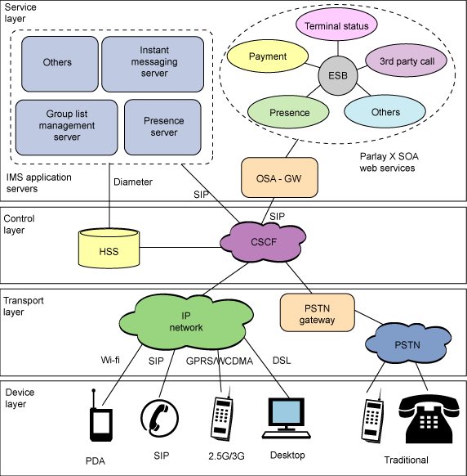
IP Multimedia Subsystem
Service
layer
Terminal Status
Others
IP Messaging
Server
Payment
3rd Party Call
ESB
Voice/Video call
Server
Presence
Server
Presence
Others
IMS application
server
OSA-GW
Control
layer
HSS
CSCF
Transport
layer
IP
network
PSTN
gateway
PSTN
Wi-Fi
SIP
GPRS\WBCDMA
DSL
Device
layer
PDA
SIP
Cellular
Desktop
Traditional

